Slide 1
Can we create inflation whenever we want?
Dr. V. Anantha Nageswaran

Slide 2
Introduction
Costs of extremely high inflation easy to see
If prices rise rapidly enough, money stops being a useful medium of exchange
Costs of low, expected inflation are difficult to see
Regardless, public has a distaste for it → becomes a policy issue
Unexpected inflation has distributional cost (debtors vs. creditors)

Slide 3
The Costs of Inflation
Perfectly anticipated inflation: Suppose an economy has been experiencing inflation of 5% and the anticipated rate of inflation is also 5%, then all contracts will build in the expected 5% inflation
Nominal interest rates account for the inflation
Long term labor contracts account for the inflation
Tax brackets are typically adjusted to account for the inflation
→ Inflation has no real costs, except for two qualifications:
The costs of holding currency rise along with the rate of inflation, and the demand for currency decreases
Menu costs of inflation

Slide 4
The Costs of Inflation
Imperfectly anticipated inflation: full adjustment to inflation does not describe economies in the real world → imperfectly anticipated
Most contracts are written in nominal terms
If inflation is unexpectedly high, debtors repay loans in cheaper dollars
If inflation in unexpectedly low, debtors repay loans in more valuable dollars (take a loss)
The possibility of unexpected inflation introduces an element of risk, which might prevent some from making some exchanges they otherwise would undertake
Unanticipated inflation redistributes wealth and income

Slide 5
The Costs of Inflation
Redistribution effect operates with respect to all assets fixed in nominal terms
Money, bonds, savings accounts, insurance contracts, some pensions
Realized real interest rates are lower than nominal interest rates if inflation

Slide 6
Why did inflation decline from the 1980s?
Was the success of inflation targeting due to monetary policy?

Slide 7
Shift from labour to capital

Slide 8
In the United Kingdom too
UK Compensation of Employees/GDP.
Source: Office of National Statistics, UK

Slide 9
Compensation costs and inflation in the UK
UK: Growth in Compensation Costs and Retail Price Index Inflation
Source: Office of National Statistics

Slide 10
Compensation costs and inflation in the US

Slide 11
Wages and inflation in the United States

Slide 12
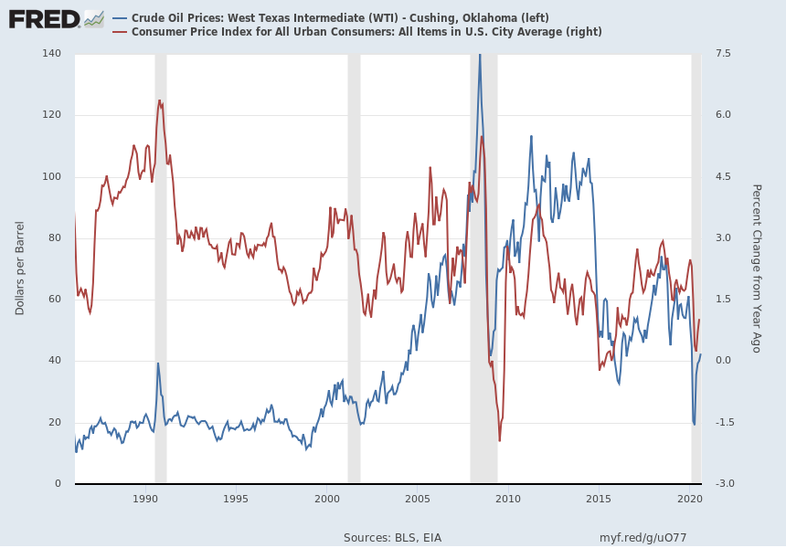
Commodities matter for inflation but not always
Notes:
Source: U.S. Energy Information Administration Release: Spot Prices Units: Dollars per Barrel, Not Seasonally Adjusted Frequency: Daily Definitions, Sources and Explanatory Notes U.S. Energy Information Administration, Crude Oil Prices: West Texas Intermediate (WTI) - Cushing, Oklahoma [DCOILWTICO], retrieved from FRED, Federal Reserve Bank of St. Louis; https://fred.stlouisfed.org/series/DCOILWTICO, August 27, 2020. Source: U.S. Bureau of Labor Statistics Release: Consumer Price Index Units: Index 1982-1984=100, Seasonally Adjusted Frequency: Monthly The Consumer Price Index for All Urban Consumers: All Items (CPIAUCSL) is a measure of the average monthly change in the price for goods and services paid by urban consumers between any two time periods. It can also represent the buying habits of urban consumers. This particular index includes roughly 88 percent of the total population, accounting for wage earners, clerical workers, technical workers, self-employed, short-term workers, unemployed, retirees, and those not in the labor force. The CPIs are based on prices for food, clothing, shelter, and fuels; transportation fares; service fees (e.g., water and sewer service); and sales taxes. Prices are collected monthly from about 4,000 housing units and approximately 26,000 retail establishments across 87 urban areas. To calculate the index, price changes are averaged with weights representing their importance in the spending of the particular group. The index measures price changes (as a percent change) from a predetermined reference date. In addition to the original unadjusted index distributed, the Bureau of Labor Statistics also releases a seasonally adjusted index. The unadjusted series reflects all factors that may influence a change in prices. However, it can be very useful to look at the seasonally adjusted CPI, which removes the effects of seasonal changes, such as weather, school year, production cycles, and holidays. The CPI can be used to recognize periods of inflation and deflation. Significant increases in the CPI within a short time frame might indicate a period of inflation, and significant decreases in CPI within a short time frame might indicate a period of deflation. However, because the CPI includes volatile food and oil prices, it might not be a reliable measure of inflationary and deflationary periods. For a more accurate detection, the core CPI (CPILFESL) is often used. When using the CPI, please note that it is not applicable to all consumers and should not be used to determine relative living costs. Additionally, the CPI is a statistical measure vulnerable to sampling error since it is based on a sample of prices and not the complete average. For more information on the consumer price indexes, see: Bureau of Economic Analysis. "CPI Detailed Report." 2013. Handbook of Methods Understanding the CPI: Frequently Asked Questions U.S. Bureau of Labor Statistics, Consumer Price Index for All Urban Consumers: All Items in U.S. City Average [CPIAUCSL], retrieved from FRED, Federal Reserve Bank of St. Louis; https://fred.stlouisfed.org/series/CPIAUCSL, August 27, 2020.

Slide 13
A big question
If Central Bankers succeeded in controlling inflation since the 1980s, why are they still not successful in creating inflation, after 2008?
Again, the asymmetry of policy effectiveness!

Slide 14
Real factors behind the ‘Great Moderation’
Negative commodities price shock in the 1980s
Beginning of globalisation; GATT rounds and WTO – reduction in or elimination of tariffs
Immigration of labour and/or outsourcing or offshoring of jobs - labour arbitrage
Waning influence of labour unions
Technological improvements and productivity impact

Slide 15
Post-2008: reasons behind failure to ‘generate’ inflation
Asymmetry of policy impact on sentiment: Higher rates can curb inflation; lower rates cannot raise inflation expectations because behavioural messaging changes drastically
Asymmetric impact on CFO: CFOs raise hurdle rates when policy rates raise meaningfully. But, they do not lower them. No CFO wants to be remembered for accepting lower return projects.
Inflation is more a function of real factors (some of them named below) than monetary factors

Slide 16
Continued from previous slide
In the presence of high leverage and structural growth impact, monetary policy only affects financial variables
Fiscal policy should have complemented monetary policy targeting low and middle income population quintiles or deciles for their propensity to spend is higher. Erosion in networth of all but the top decile or quintile of the American population is yet to be made up
Enduring factors such as labour insecurity and wage competition from developing world continued to operate

Slide 17
The BIS view of what determines inflation outcomes – where is money?!
Likewise, inflation is a highly imperfect gauge of sustainable economic expansions, as became evident pre-crisis.
This would especially be expected in a highly globalised world in which competitive forces and technology have eroded the pricing power of both producers and labour and have made the wage-price spirals of the past much less likely.
Source: BIS Annual Report (2015-16)

Slide 18
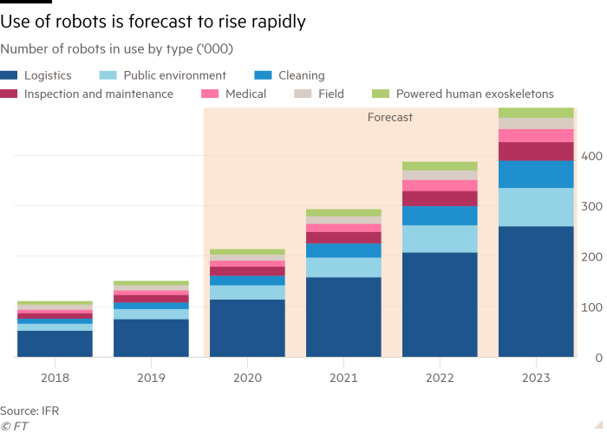
What does this do to worker anxiety?
Source: ‘Pandemic boosts automation and robotics’, Financial Times, 20th October 2020 (https://www.ft.com/content/358f6454-e9fd-47f3-a4b7-5f844668817f)

Slide 19
Inflation will have to wait
Source: ‘Pandemic boosts automation and robotics’, Financial Times, 20th October 2020 (https://www.ft.com/content/358f6454-e9fd-47f3-a4b7-5f844668817f)

